Slide 1

RestWell
Reclaiming Sleep. Rebuilding Lives.

Slide 2

The world is sleep-deprived—and it’s costing us
Sleep deprivation is a global health crisis.
1 in 3 adults don’t get enough sleep, contributing to anxiety, burnout, and chronic illness.
Poor sleep impacts productivity, academic performance, mental health, and long-term well-being.

Slide 3

The Opportunity
1
Growing focus on wellness and burnout recovery
2
Sleep solutions rarely include behavior change or community support
3
Market lacks a science-backed, engaging platform for sleep health

Slide 4

Our Solution: RestWell
A digital wellness platform that transforms sleep habits through:
o Personalized assessments
o Virtual coaching
o Wearable syncing
o Sleep challenges
From sleep tracking to sleep transformation
Play the video on the right to see a quick example.

Slide 5



Who We Help
1
University students under pressure
2
Shift workers facing circadian disruption
3
Professionals battling burnout

Slide 6


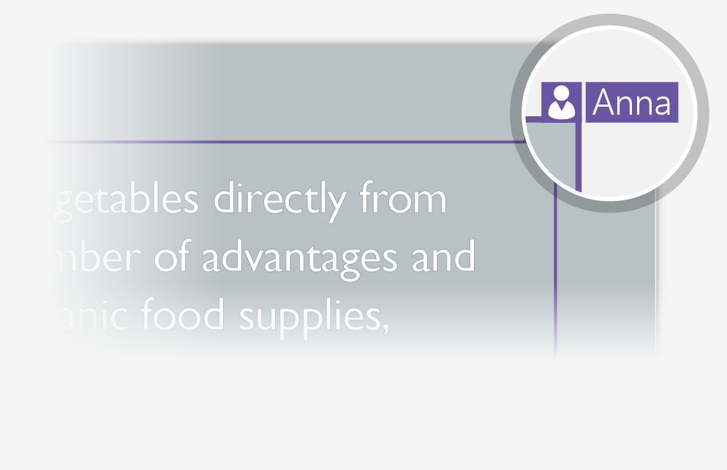
The Results So Far
Aligns with SDG 3: Good Health and Well-Being
How it works:
1
-50% in sleep-related anxiety
2
+35% increase in nightly sleep,
3
Pilot with 250 users showed higher focus & mood scores

Slide 7


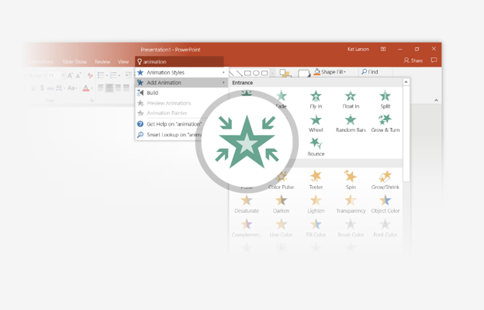
Business & Growth Model
SELECT ME
Freemium app + premium sleep coaching
1
2
B2B partnerships with schools & clinics
Anonymous sleep trend data for institutions
3

Slide 8

Explore Why We’re Different
Focus on behavioral change
1
Community-driven habit building
2
Inclusive, accessible design for all devices
3
Built on real human insight, not just numbers

Slide 9
Vision
To shift the cultural mindset from “sleep is optional” to “rest is essential.”
A future where quality rest is seen as a right—not a luxury
Sleep wellness as a public health revolution

Slide 10
Questions
Join us in making sleep a global wellness priority
Email: Mpho.Maphalle@gmail.com
Contact: 0613716818

